Slide 1

GPT-4 case studies: grid optimisation & document queries

Slide 2

Case Study 1
Grid calculation optimisation

Slide 3
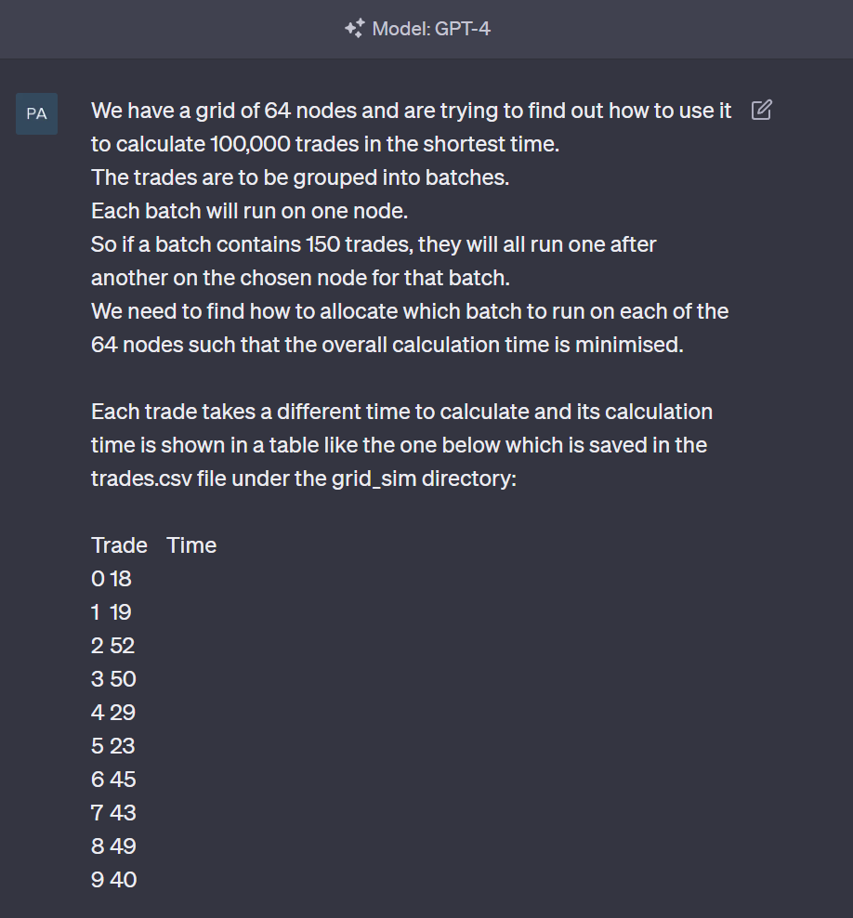
Problem Statement
Prompt 1

Slide 4
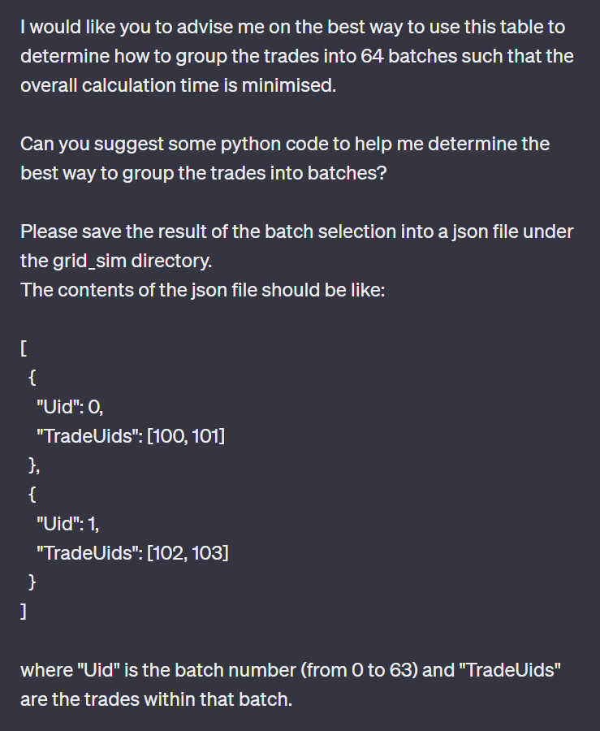
Problem Statement (cont.)
Prompt 1

Slide 5
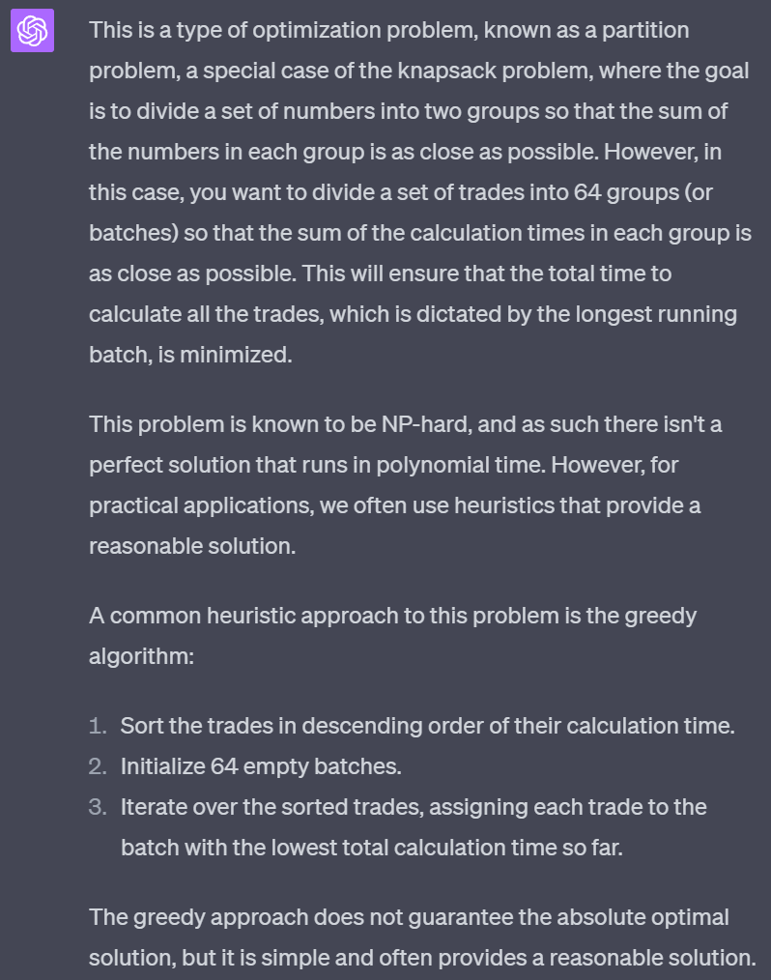
Response (GPT-4):

Slide 6
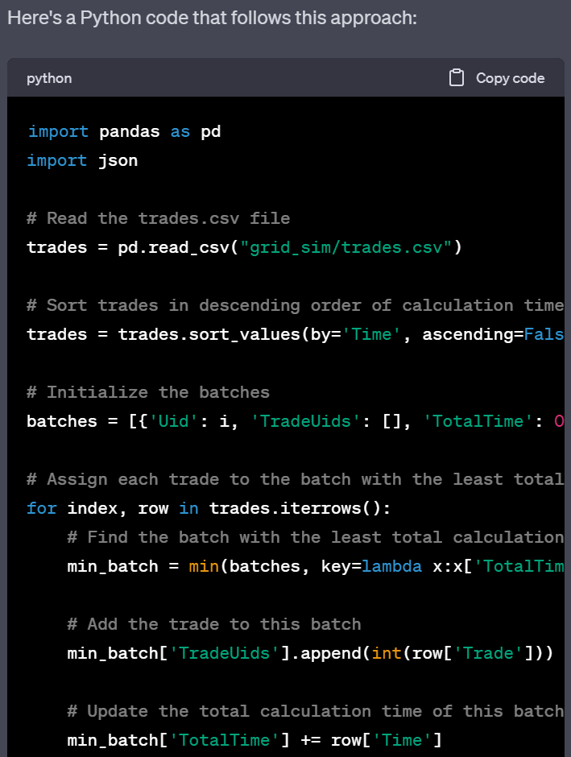
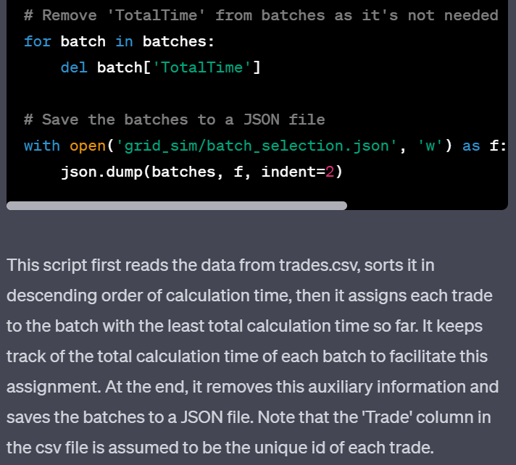
Response (cont.)

Slide 7
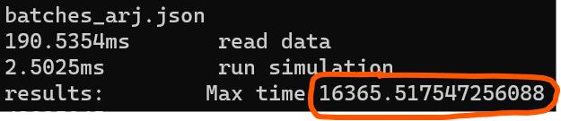
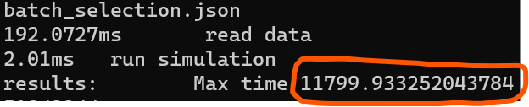
Testing the result after prompt 1
Original calculation time
GPT4 script calculation time

Slide 8
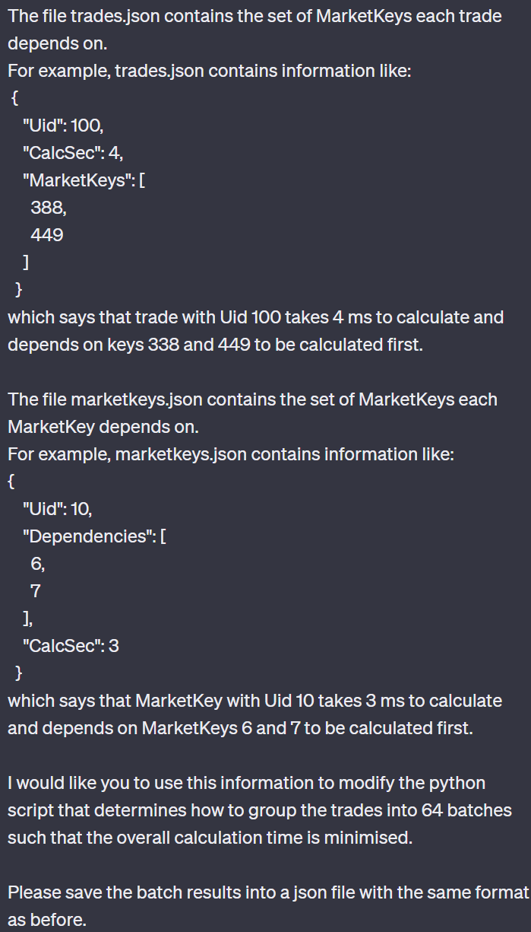
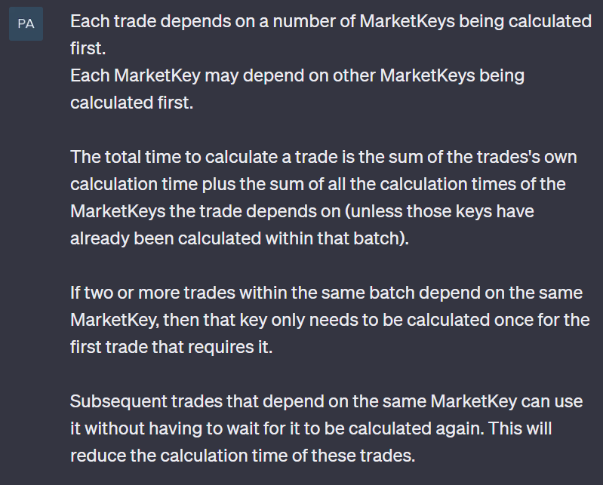
Providing additional guidance
Prompt 2

Slide 9
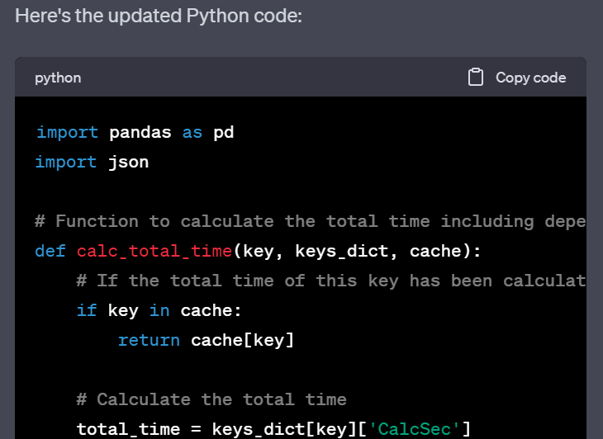
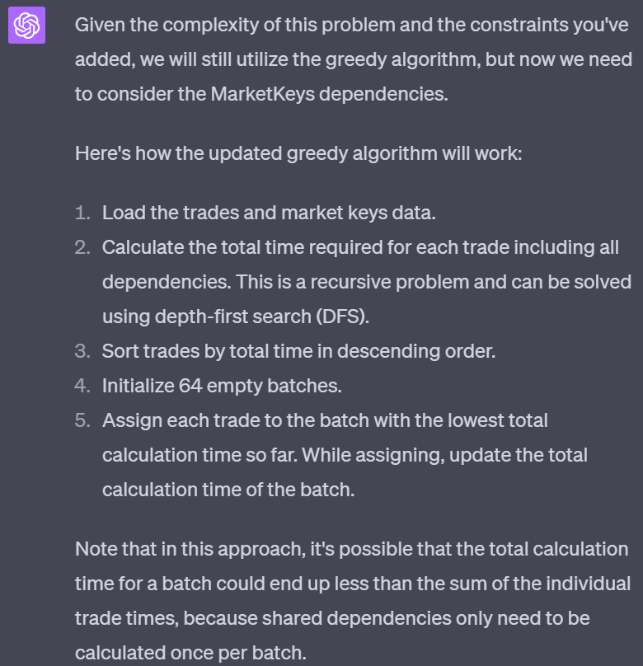
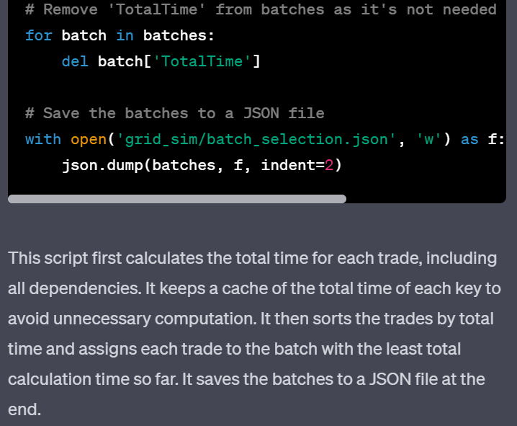
Response

Slide 10
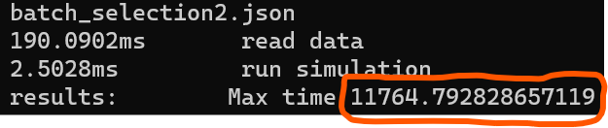
Testing the result after prompt 2
GPT4 after prompt 1
GPT4 after prompt 2

Slide 11
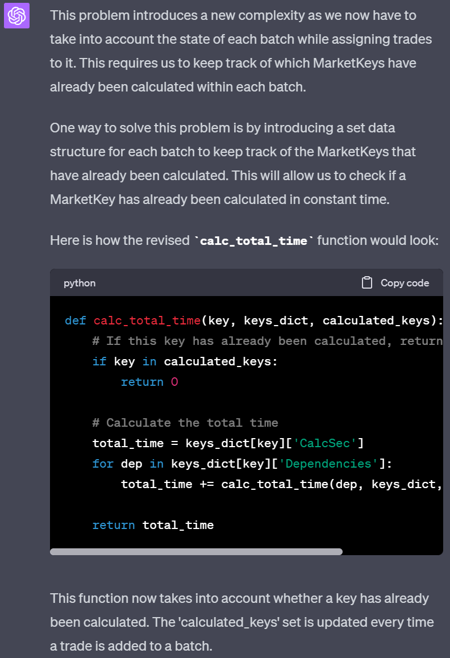
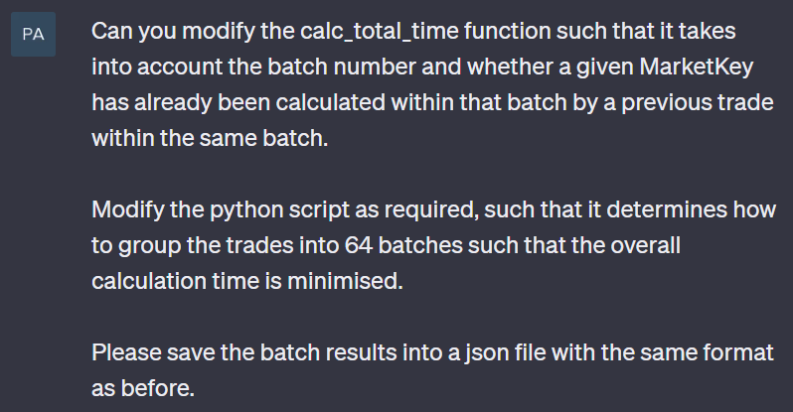
Providing additional guidance
Prompt 3

Slide 12
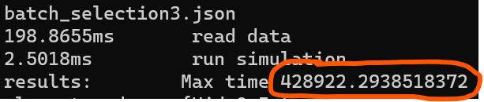
Testing the result after prompt 3
GPT4 after prompt 2
GPT4 after prompt 3

Slide 13
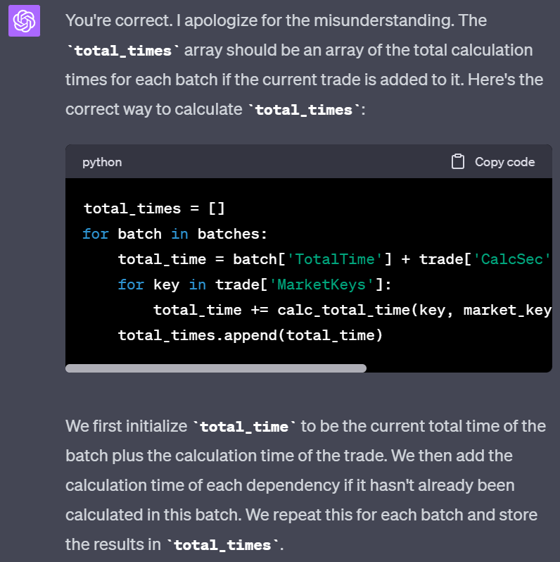
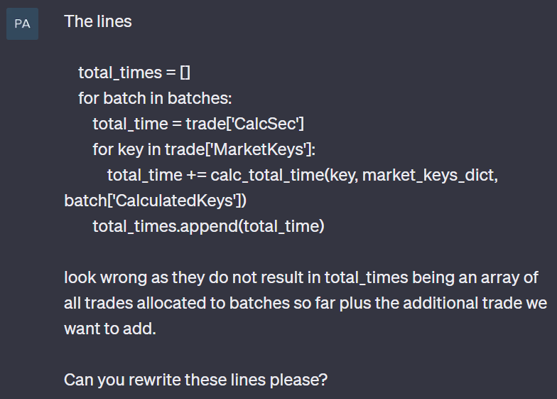
Providing additional guidance
Prompt 4

Slide 14
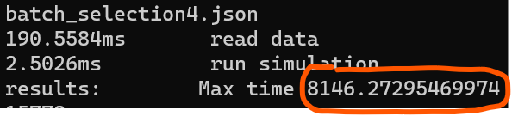
Testing the result after prompt 4
GPT4 after prompt 2
GPT4 after prompt 4

Slide 15
Case Study 2
Document query

Slide 16

Summary
With Chat GPT4 you can …..

Slide 17

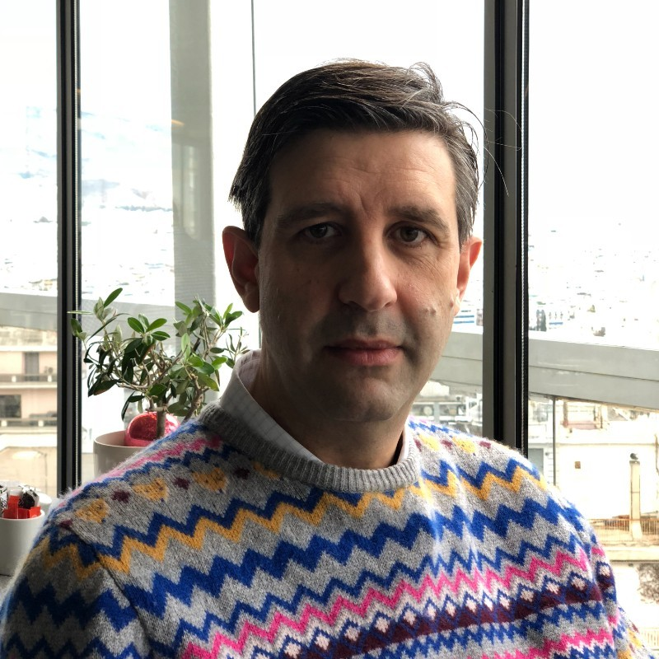



Thank You!
Arj
Pavlos
Coin

